Slide 1
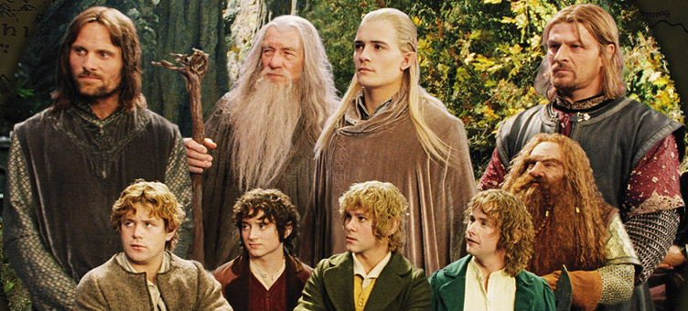

The Fellowship of the Data
Source:myblogs.pw
Sev Leonard
sev@thedatascout.com
gizm0_0

Slide 2
Ways to play
View the PowerPoint presentation at http://tinyurl.com/j6xpkvu
Follow along with the presentation and Jupyter notebooks on Github
https://github.com/gizm00/pycon2016
notebooks directory will have the labs
PDF version of presentation
Run tutorial locally in Jupyter – see Github for required libs
Need to use CsvStorage object (more on this later)
Form scraping will not run
Run Docker tutorial container - same caveats as local run
Run Docker LAMP stack and tutorial container

Slide 3
Set the timer! 45min

Slide 4

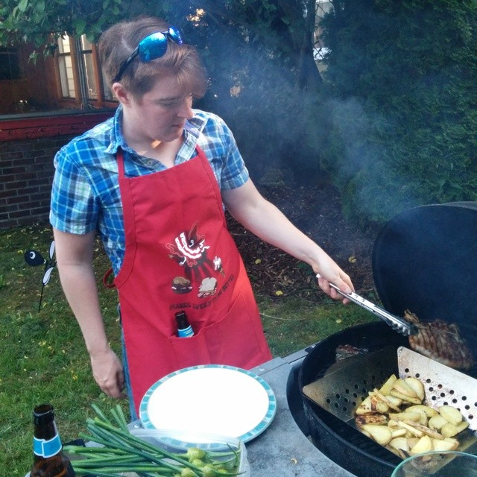

Greetings! About me
My pronoun.is/he
11 years in PDX
1st PyCon!
Software and “data science” consultant
Likes mangoes, outside, cats

Slide 5
Class info
Tutorial content & setup instructions: https://github.com/gizm00/pycon2016
HTTP requests, MYSQL storage are handled by the pycon2016_lamp Docker container
You will be able to run most of the tutorial without this if it is giving you grief
Tutorial is based on data source mocks

Slide 6
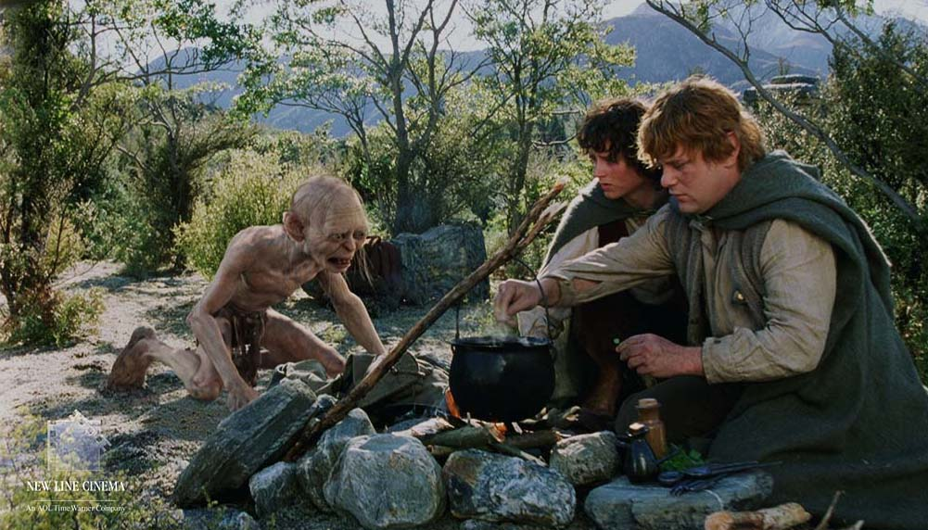
About the tutorial
Based on data gathering and organization techniques used for www.campnear.me
Source:artistthinks.wordpress.com

Slide 7
Tutorial topics
Mostly lab (Jupyter notebook) based
Data gathering topics:
Working with APIs
Scraping webpages
Navigating forms
OOD topics:
Creating uniform interfaces through abstraction
Extending classes
Encapsulating methods, data

Slide 8
Agenda
Overview of data sources, best practices for web data, and design techniques
Labs
Getting data from an API
Creating objects for storing and extracting data
Scraping web pages
Creating objects for scraping data
Navigating forms
Using the scraper object for reservation info
Creating objects to merge data
The One Pipeline

Slide 9
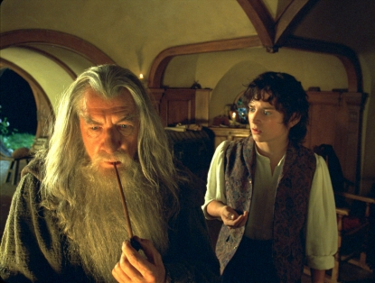
There and back again – a journey
Image source: knightleyemma.com

Slide 10
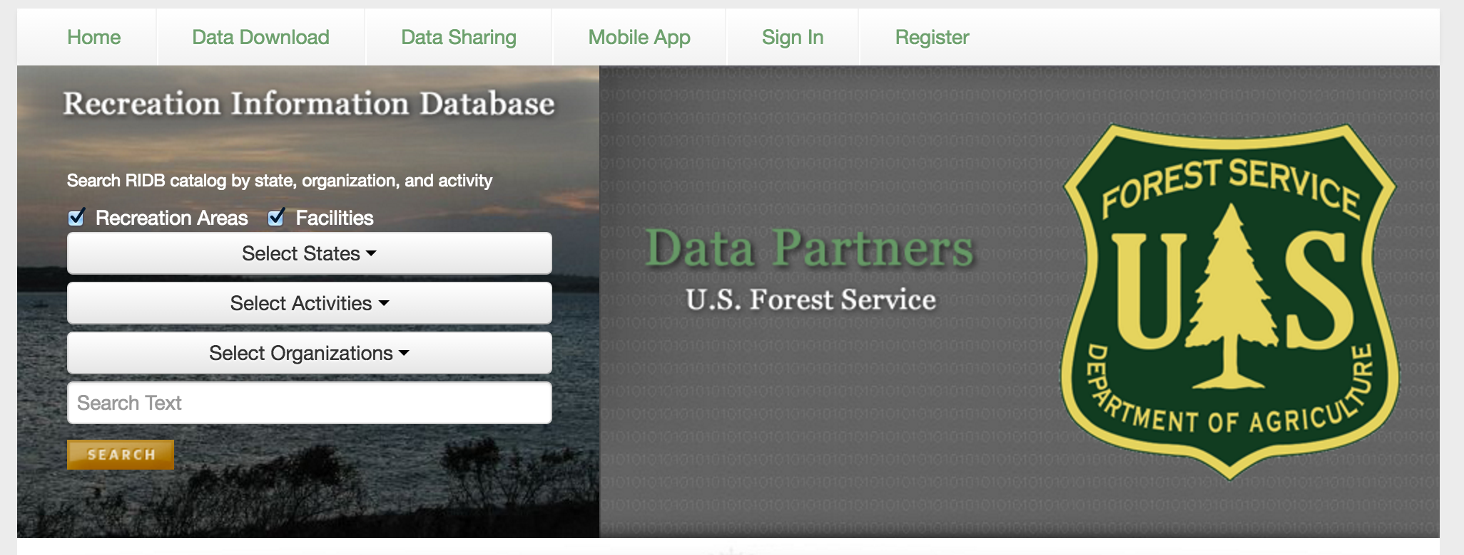
Recreation Information Database - RIDB
ridb.recreation.gov

Slide 11
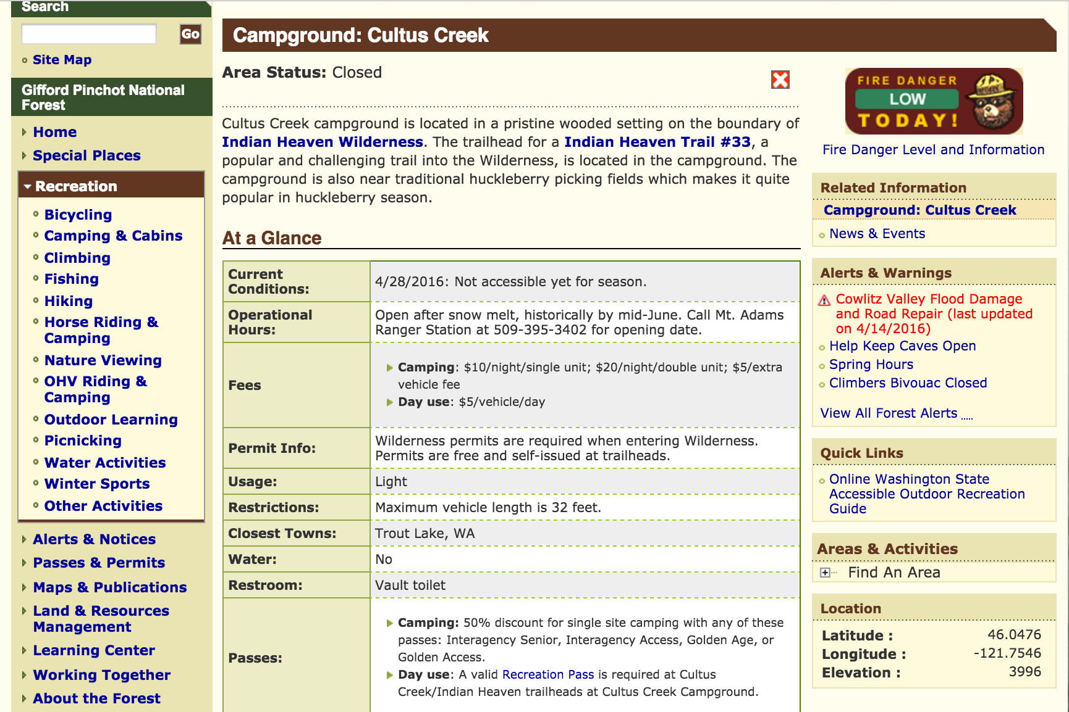
US Forest Service Websites

Slide 12
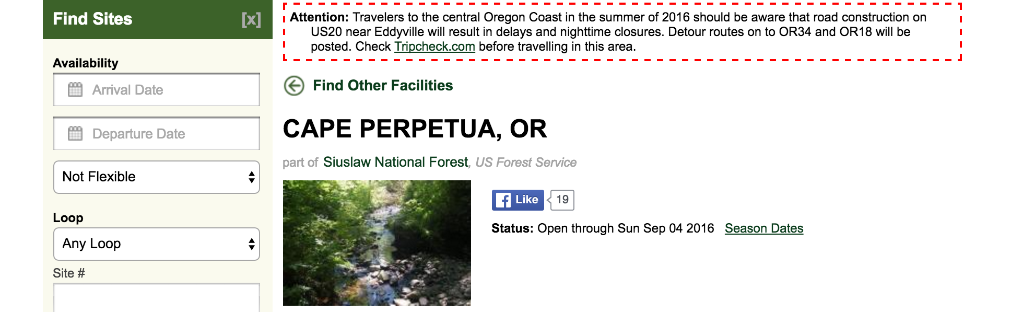
Recreation.gov

Slide 13
Tidy data principles
Each variable is a column
Each observation is a row
Each type of observational unit is a table
Source: Wickham 2014 http://www.jstatsoft.org/v59/i10/paper
Observation: campground
Variables: lat/long, name, website, etc
Observational unit – data source (RIDB, USFS, recreation.gov)

Slide 14

Web data best practices
Source:kaiju.wikidot.com

Slide 15
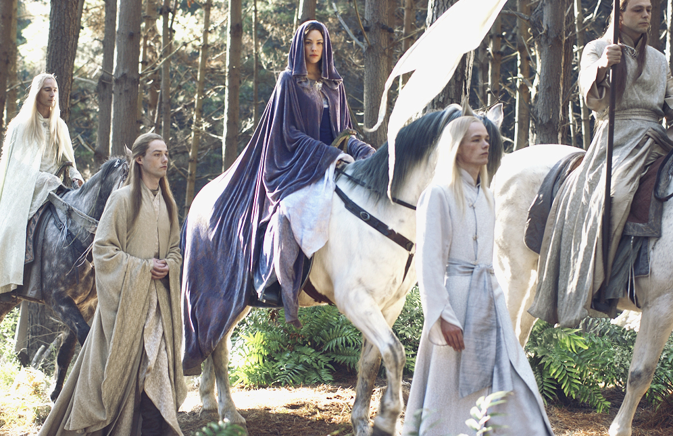
1. Web data is ephemeral
Source:lotr.wikia.com
Format, availability, access requirements can change at any time

Slide 16
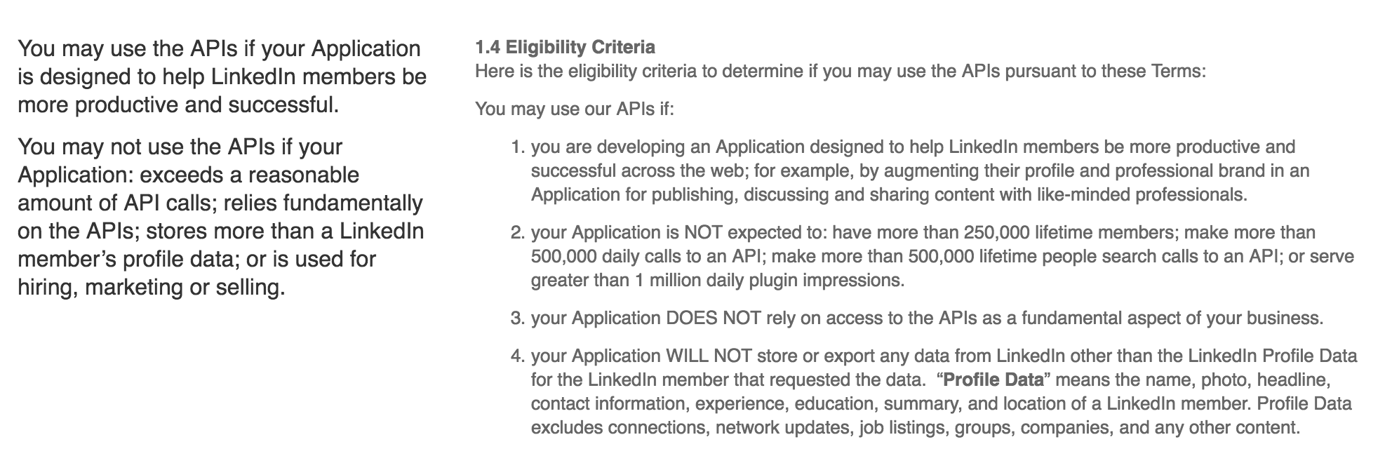
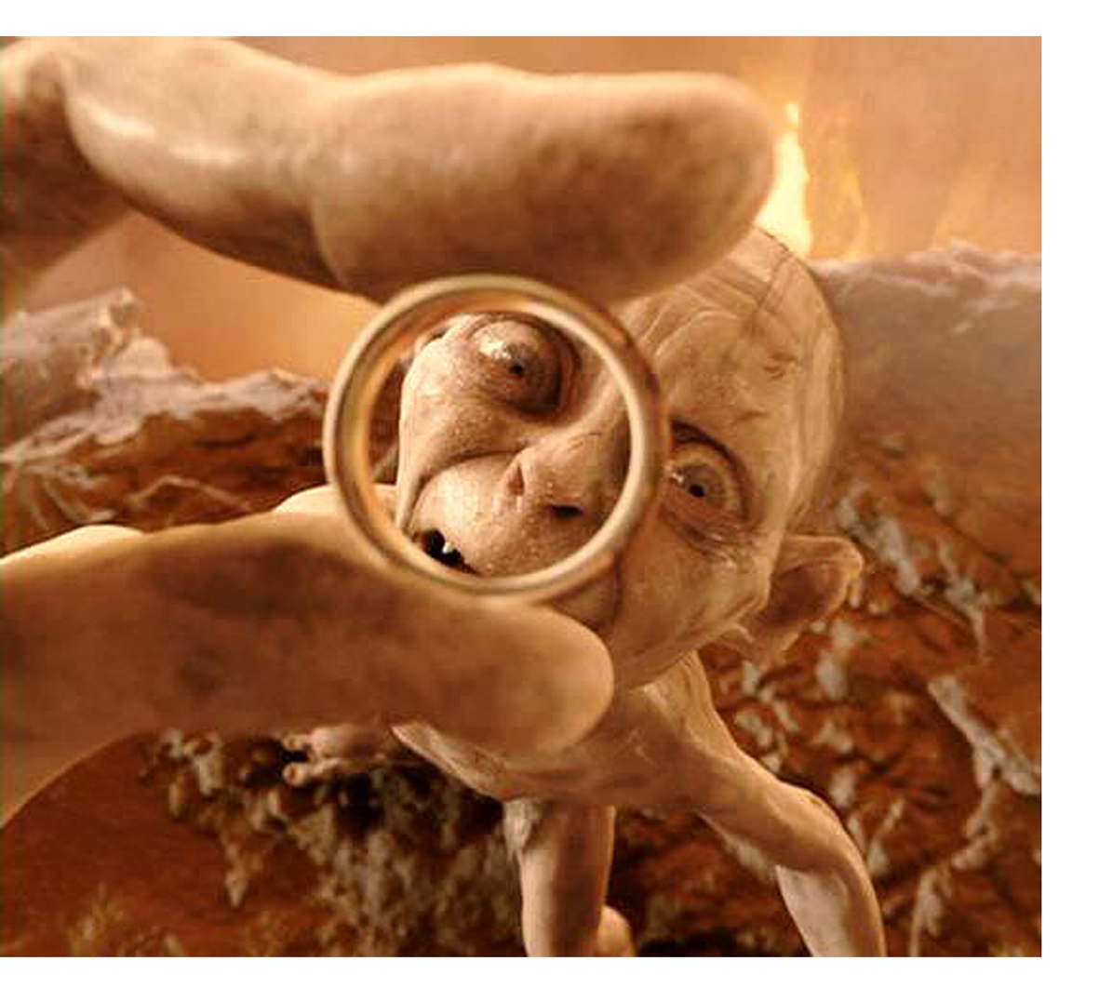
2. Just because you can get the data…
https://developer.linkedin.com/legal/api-terms-of-use
Source:realitysandwich.com

Slide 17
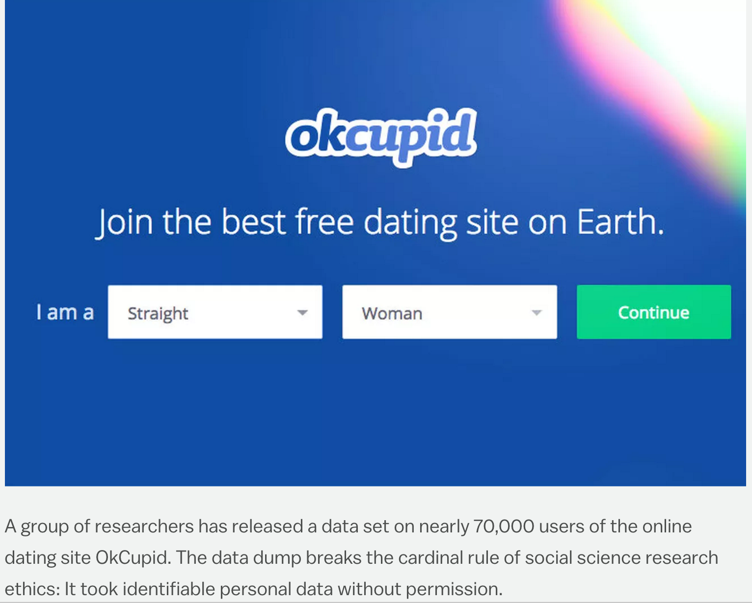

… doesn’t mean you can use it
http://www.vox.com/2016/5/12/11666116/70000-okcupid-users-data-release
Source:doblu.com

Slide 18
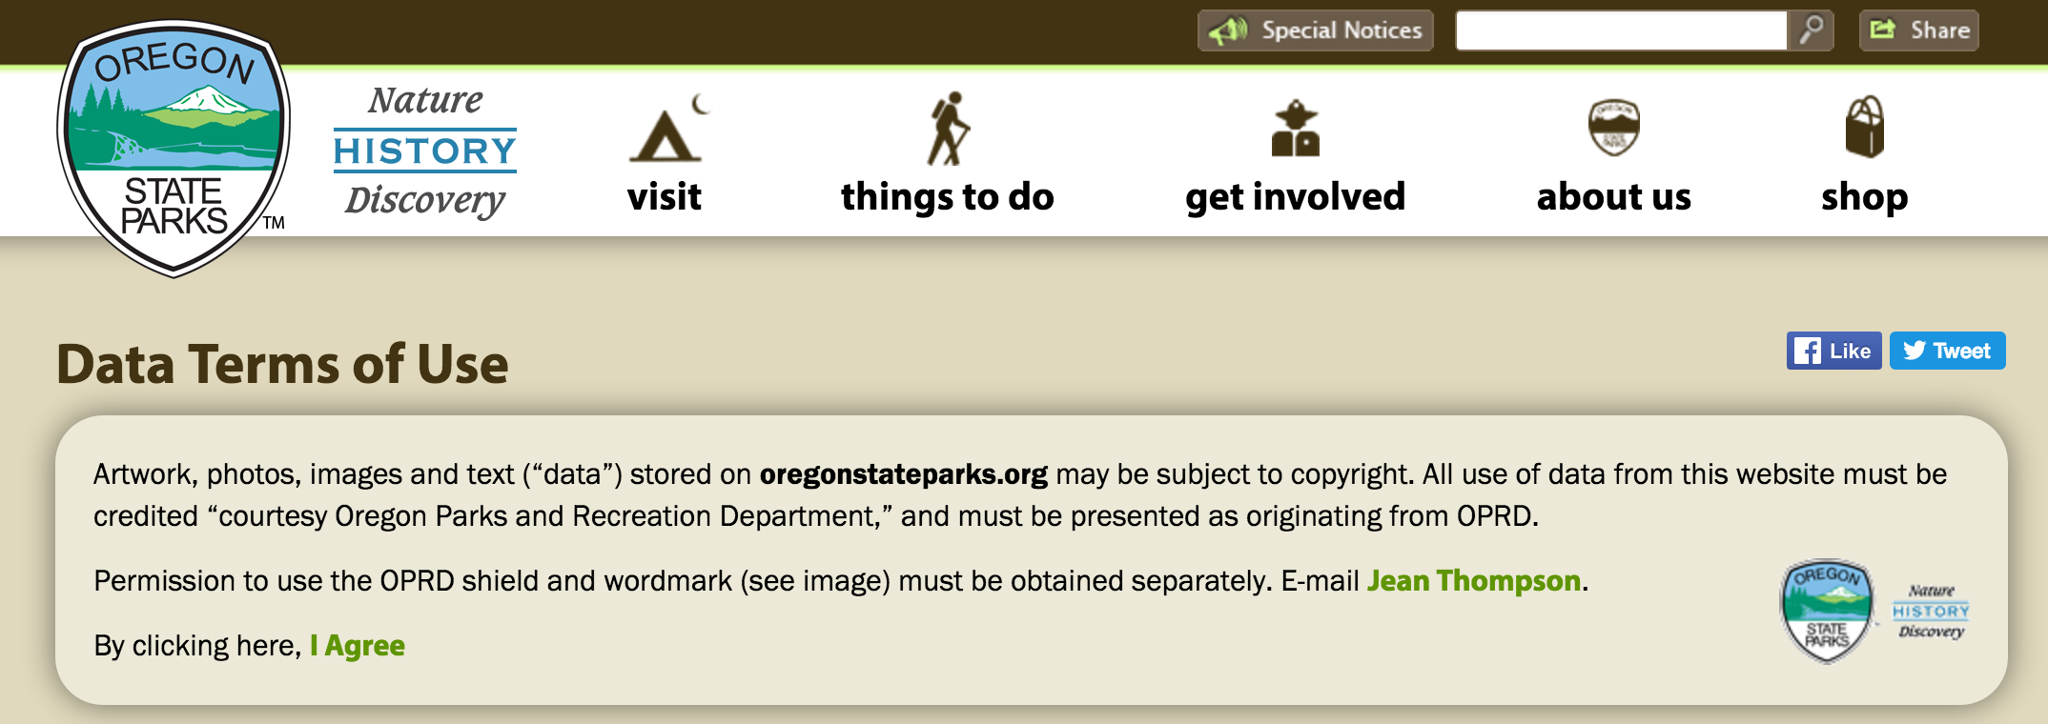
3. Terms of Use - attribute properly
Source:oregonstateparks.org

Slide 19

4. Be aware of rate limits, server loading
Source:lotr.wikia.com

Slide 20
Web data summary
Highly dynamic!
Structure of webpages
Access / permissions
API versions, output formats, parameters, rate limits
May not be there tomorrow
Potential to be blocked for excessive scraping or API abuse

Slide 21
Object Oriented Programming
Class-based design
SOLID principles
Classes should do one job
Instead of modifying existing classes, extend through sub classes
Class dependencies should be abstract, not concrete*
* Abstract base classes are not Pythonic, but are used in this tutorial for teaching purposes
Read more about SOLID: https://scotch.io/bar-talk/s-o-l-i-d-the-first-five-principles-of-object-oriented-design

Slide 22
How can object oriented design help?
Encapsulate properties that are likely to change
API endpoints, parameters, etc
Build on abstractions to allow flexibility
Consistent interfaces for Data objects, regardless of source
Extend existing classes to accommodate changes
Create WebScraper objects that can be extended
Create testable, maintainable structures

Slide 23
RIDB API
ridb.recreation.gov

Slide 24
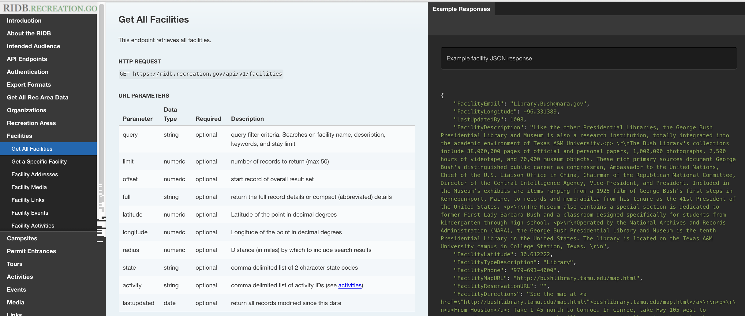
RIDB API Documentation
http://usda.github.io/RIDB

Slide 25
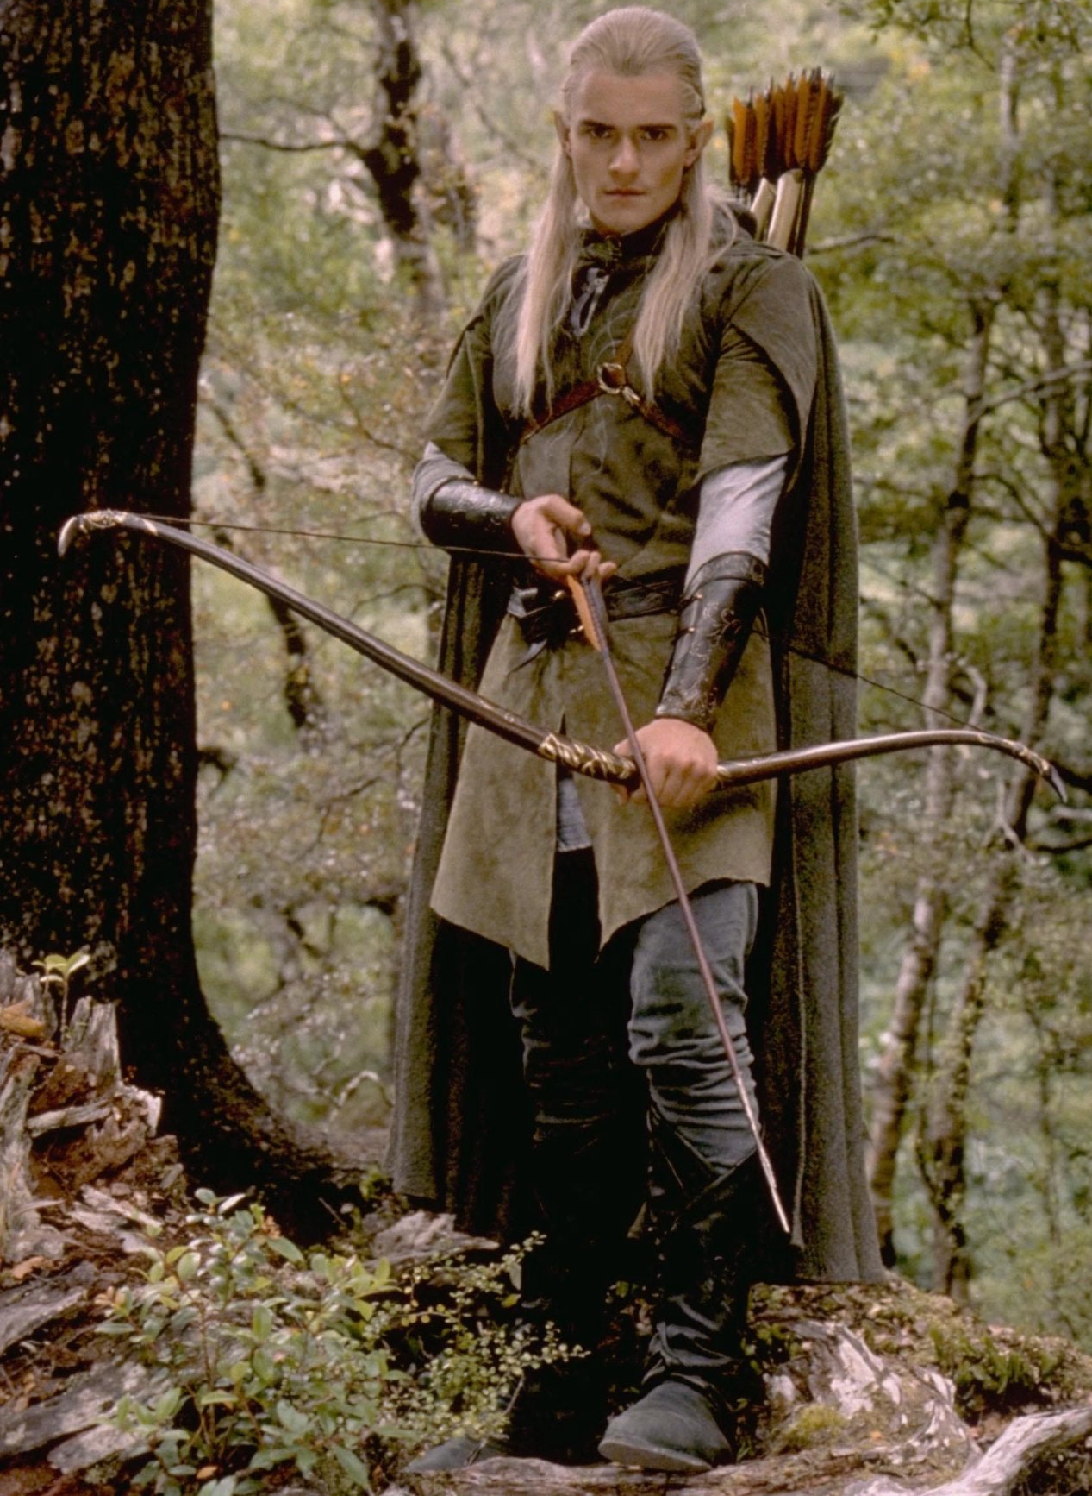

RIDB data notes
Only has campgrounds that can be reserved – no first come, first serve
Missing reservation URLs
Lat / Longs not guaranteed to be accurate

Slide 26
Lab 1 & 2

Slide 27
Lab 1 & 2 summary
Connect to source
Data object
Extract data
RidbData
object
Clean / format data
Merge
Store
Analyze
Storage object

Slide 28
Storage
Data
MysqlStorage
RidbData
CsvStorage
RidbDataLive

Slide 29
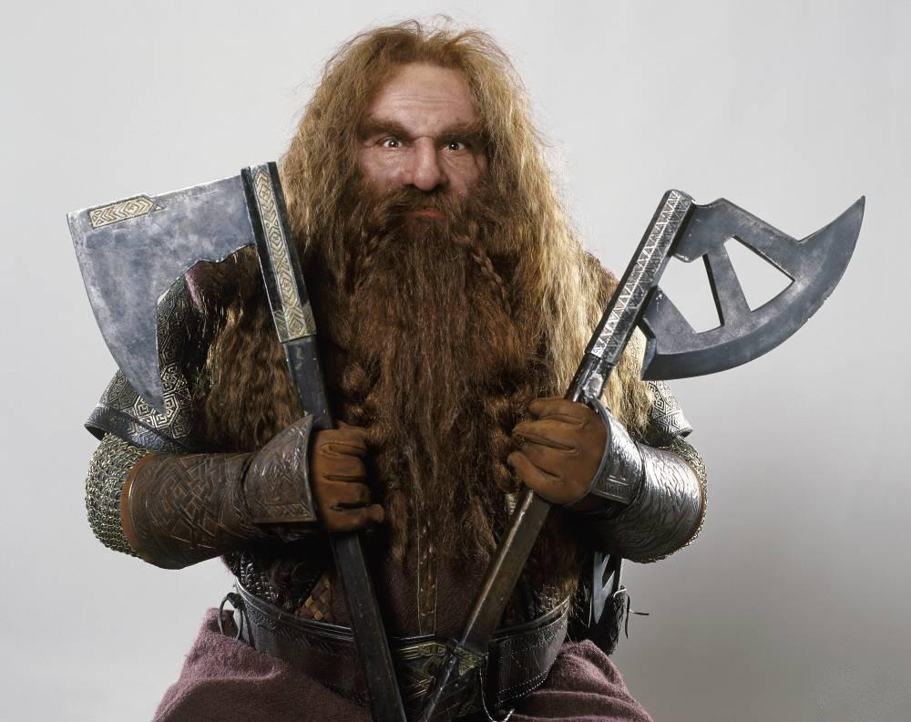
USFS Website scraping
Selenium
BeautifulSoup

Slide 30
USFS Data
No API
Links are discovered through scraping (already done)
Pages are fairly uniform!

Slide 32
Lab 3 & 4

Slide 33
Saving tutorials with OOD!
Storage
Data
Scraper
MysqlStorage
ScraperData
UsfsWebScraper
CsvStorage
UsfsWebScraperLocal

Slide 34
Recreation.gov reservation scraping

Slide 35
Lab 5 & 6

Slide 36
Lab 5 & 6 objects
Storage
Data
Scraper
MysqlStorage
ScraperData
UsfsWebScraper
CsvStorage
ReservationsScraper

Slide 37
Merging all the data – Lab 7
Data merge is based on Lat/Long
But remember, lat/longs are frequently not correct!
Some error
Merge / join will be based on the distance between campgrounds being below a certain threshold

Slide 38
Lab 7 objects
Data
RidbData
ScraperData
DistanceMergeData
RidbDataLive

Slide 39
Lab 8 - The One Pipeline

Slide 40

Thanks!
Image source:lotr.wikia.com

Slide 41
Backup

Slide 42
The ideal data pipeline
Connect to source
Connect to source
Extract data
Extract data
Clean / format data
Clean / format data
Merge
Store
Analyze
Merge
Store
Analyze

Slide 43
RIDB API
NF websites
Connect to source
Connect to source
Extract data
Merge
Extract data
Reservations
Connect
Store
Clean / format data
Extract
Store
Merge
Merge
Analyze

Slide 44
Look across
Connect to source
Connect to source
Extract data
Extract data
Clean / format data
Clean / format data
Merge
Store
Analyze
Merge
Store
Analyze

